Slide 1
Mathematics (9-1) - iGCSE
2018-20
Year 09
Unit 13 – Answers

Slide 2
13 - Prior knowledge check
Page 675
a. 1.5 b. 5.8
13.3
5.62
22.0
104.5°
a. 2 b. $\sqrt{2}$
a. 30.5° b. 38.7°
a. 35.0cm b. 12.4cm
21cm²

Slide 3
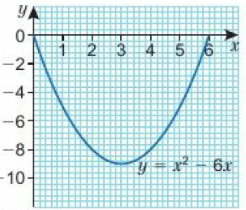
13 - Prior knowledge check
Page 675
a. b. c. x = 1 or x = 5
16
x | 0 | 1 | 2 | 3 | 4 | 5 | 6
y | 0 | -5 | -8 | -9 | -8 | -5 | 0

Slide 4
13.1 - Accuracy
Page 675
Key: UB = upper bound; LB = lower bound
a. UB: y = 3.65; LB: y = 3.55 b. UB: z = 9.25; LB: z = 9.15 c. UB; x = 33.7625 d. LB; x = 32.4825
a. UB; y = 1.25; LB: y = 1.15 b. UB; z = 0.45; LB; z = 0.35 c. UB: x = $\frac{25}{7}$ d. LB: x = $\frac{23}{9}$

Slide 5
13.1 - Accuracy
Page 675
Key: UB = upper bound; LB = lower bound
a. i. 7.45cm ii. 8.65cm b. 11.416 (3 d.p.) c. i. 7.35cm ii. 8.55cm d. 11.274 (3 d.p.)
a. LB = 42.922° (3 d.p.); UB = 45.136° (3 d.p.) b. LB for x gives UB for cos x and UB for x gives LB for cos*
a. UB: x = 29.949; LB: x = 29.846 b. x = 30° (to the nearest degree)

Slide 6
13.1 - Accuracy
Page 675
Key: UB = upper bound; LB = lower bound
a. UB; x = 30.172; LB; x = 29.155 b. x = 30° (to the nearest 10 degrees)
UB; x = 7.938; LB; * = 7.757
UB; x = 275.213; LB; x = 223.811
UB; x = 3.187; LB; * = 3.110

Slide 7
13.2 – Graph of the Sine Function
Page 675
a. 1 b. 0.6
0.28
a. 0.6 b. 0.4 c. -0.2 d. -0.8
a. 1 b. -1 c. 0°, 180°, etc.
150°
a. Decreases from 1 to 0 b. Decreases from 0 to -1 c. Increases from -1 to 0

Slide 8
13.2 – Graph of the Sine Function
Page 675
a. i. 7 ii. 0.96 b. Reflection symmetry with mirror line x = 90⁰ d. i. 120° ii. 135⁰ iii. 180⁰ iv. 150⁰ e. Answers from 12° to 18°
Rotational symmetry of order 2 about (180, 0)
a. Students' graph of y = sin x for the interval 0° ≤ x ≤ 540° b. i. 0 ii. 1 c. i. $\frac{\sqrt{3}}{2}$ ii. $\frac{\sqrt{3}}{2}$
The graph repeats, so sin 420° is the same as sin 60°. The graph is symmetrical between x = 360° and x = 540°, so sin 480° = sin 420°.

Slide 9
13.2 – Graph of the Sine Function
Page 675
a. 210°, 330°, 570°, 690° b. 240°, 300°, 600°, 660°
A(90, 1), B(180, 0), C(270, -1), D(360, 0)
18.2°, 161.8°, 378.2°, 521.8°
56.4°, 123.6°, 416.4°, 483.6°

Slide 10
13.3 – Graph of the Cosine Function
Page 675
a. 0.8 b. 0.96
a. 0.4 b. -0.6
300°
330°
a. Decreases from 0 to -1 b. Increases from -1 to 0 c. Increases from 0 to 1

Slide 11
13.3 – Graph of the Cosine Function
Page 675
a. i. -0.5 ii. -1 b. Reflection symmetry. Mirror line is x = 180. c. i. 300° ii. 270° iii. 240° iv. 360°
a. Students' graph of y = cos x for the interval 0° ≤ x ≤ 720° b. i. 0.5 ii. -0.5 c. i. $\frac{\sqrt{3}}{2}$ ii. - $\frac{\sqrt{3}}{2}$

Slide 12
13.3 – Graph of the Cosine Function
Page 675
a. 60°, 300°, 420°, 660° b. 150°, 210°, 510°, 570°
A(90, 0), B(180, -1), C(360, 1)
a. 35.9° b. Students’ graph of y = cos x for the interval 0° ≤ x ≤ 720° c. 35.9°, 324.1°, 395.9°, 684.1°
117.0°, 243.0°, 477.0°, 603.0°

Slide 13
13.4 – The Tangent Function
Page 675
a. 1 b. 0.225
a. 0.6 b. 0.6 c. -1.2 d. 1.5
240°
a. 315° b. 165°
a decreases from 0 to minus infinity b increases from 0 to infinity c decreases from 0 to minus infinity

Slide 14
13.4 – The Tangent Function
Page 676
a. Every 180°
i. 1.7 ii. -1.7
Rotational symmetry of order 2 about (180,0)
i. 240º ii. 280° iii. 300°
a. Students' graph of y = tan x for the interval 0° ≤ x ≤540° b. i. 0 ii. 1 c. i. A ii. –$\sqrt{3}$
a. 45°, 225°, 405°, 585° b. 135°, 315°, 495°, 675°

Slide 15
13.4 – The Tangent Function
Page 676
a. 74.7°
Students' graph of y = tan x for the interval 0° ≤ x ≤720°
74.7°, 254.7°, 434.7°
75.7°, 255.7°, 435.7°, 615.7°
a. Students' graph of y = tan x for the interval 0° ≤ x ≤ 720° b. 30°, 210°, 390°, 570°

Slide 16
13.5 – Calculating Areas and the Sine Rule
Page 676
a. A = πr² b. A = $\frac{\text{π}\text{r}\text{2}}{2}$ c. A = $\frac{\text{π}\text{r}\text{2}}{4}$ d. A = $\frac{\text{π}\text{r}\text{2}}{3}$
3.38cm (3 s.f.)
a. h = psint$θ$ b. A = $\frac{1}{2}$pqsin$θ$
a. 36.8 cm² b. 1.54 m2 7.99 cm (3 s.f.)

Slide 17
13.5 – Calculating Areas and the Sine Rule
Page 676
7.99 cm (3 s.f.)
a. 12.45 cm² (2 d.p.) b. 20.73 cm² (2 d.p.) c. 8.27cm² (2d.p.)
119 m² (3 s.f)
a. 118.0° b. 28.8mm²
164cm²

Slide 18
13.5 – Calculating Areas and the Sine Rule
Page 676
a. 22.9 cm b. 25.5cm c. 47.6m d. 14.7m
a. 48.2° b. 19.8º c. 68.9º d. 55.2º
a. 11.3 cm b. 38.7º
59.0° or 121.0^{C}
75.4° or 104.6^{C}

Slide 19
13.6 – The Cosine Rule and 2D Trigonometric Problems
Page 676
a. 067° b. 247°
5.05
23.4 cm²
a. 8.43 cm b. 8.15 cm c. 21.1cm d. 12.5 m
a. 59.6° b. 151.3° c. 99.1° d. 82.4°
106.3°

Slide 20
13.6 – The Cosine Rule and 2D Trigonometric Problems
Page 676
a. 15.4 cm b. 26.6° c. 93.7 cm²
113°
a. 16.6 km b. 291°
a. 56.3° b. 110.8°
12.7 cm

Slide 21
13.7 – Solving Problems in 3D
Page 676
a. 65.0° b. 36.7° c. 60.9°
a. 6.37 cm b. 65.6 cm
a. i. 15cm ii. 20.5 cm iii. 16.6cm iv. 20.5cm b. 43.0° c. 43.0° d. 35.8°
19.1°
a. 10.3 cm b. 6.65 cm c. 109.6°

Slide 22
13.7 – Solving Problems in 3D
Page 676
a. i. 22.6cm (3 s.f.) ii. 11.3cm (3 s.f.) iii. 21.2 (3 s.f.) b. 62° c. 21°
a. 19.8 cm b. 238cm²
32°

Slide 23
13.8 – Transforming Trigonometric Graphs 1
Page 676
a. $\frac{\sqrt{3}}{2}$ b. $\frac{1}{\sqrt{3}}$ c. $\frac{1}{\sqrt{2}}$ d. 0 e. 0 f. $\sqrt{3}$
a. Students’ graph of y = sin x for the interval 0° ≤ x ≤ 360°
Students' graph of y - cos x for the interval 10° ≤ x ≤ 360°
Students' graph of y = tan x for the interval 0° ≤ x ≤ 360°

Slide 24
13.8 – Transforming Trigonometric Graphs 1
Page 676
a.
 | x | sin x | -sin x
A | -180⁰ | 0 | 0
B | -150⁰ | -0.5 | 0.5
C | -90⁰ | -1 | 1
D | -30⁰ | -0.5 | 0.5
E | 30⁰ | 0.5 | -0.5
F | 90⁰ | 1 | -1
G | 150⁰ | 0.5 | -0.5
H | 180⁰ | 0 | 0

Slide 25
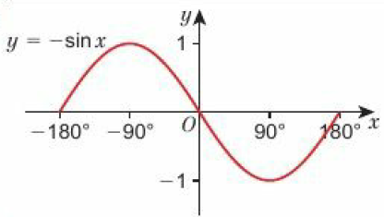
13.8 – Transforming Trigonometric Graphs 1
Page 676
b. c. Reflection in the x-axis

Slide 26
13.8 – Transforming Trigonometric Graphs 1
Page 676
a.
 | x | sin x | -sin x | sin(-x)
A | -180⁰ | 0 | 0 | 0
B | -150⁰ | -0.5 | 0.5 | 0.5
C | -90⁰ | -1 | 1 | 1
D | -30⁰ | -0.5 | 0.5 | 0.5
E | 30⁰ | 0.5 | -0.5 | -0.5
F | 90⁰ | 1 | -1 | 0
G | 150⁰ | 0.5 | -0.5 | -0.5

Slide 27
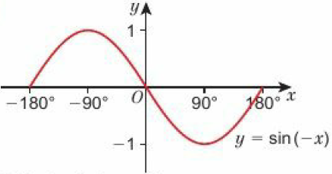
13.8 – Transforming Trigonometric Graphs 1
Page 676
b. c. Reflection in the y-axis

Slide 28
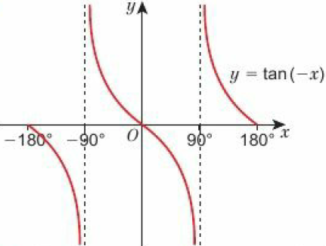
13.8 – Transforming Trigonometric Graphs 1
Page 676
a. Reflection in y-axis b. Same as graph of y – sin x
The graph has rotational symmetry of order 2 about the origin.

Slide 29
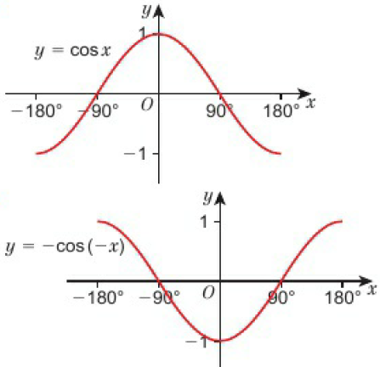
13.8 – Transforming Trigonometric Graphs 1
Page 677
a. b.

Slide 30
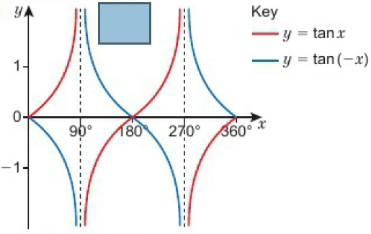
13.8 – Transforming Trigonometric Graphs 1
Page 677
a. Reflection in the y-axis b.

Slide 31
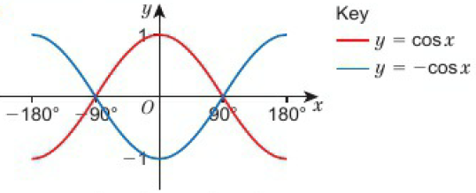
13.8 – Transforming Trigonometric Graphs 1
Page 677
a. Reflection in the x-axis b.

Slide 32
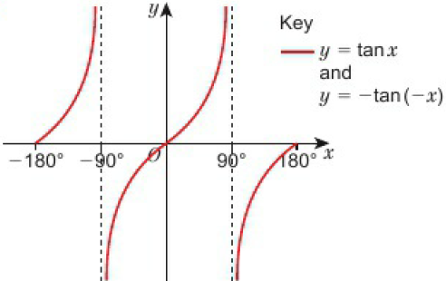
13.8 – Transforming Trigonometric Graphs 1
Page 677
a. Rotation through 180⁰ about the origin b.
P(90, -1), Q(360, 0), R(450, -1)

Slide 33
13.9 – Transforming Trigonometric Graphs 2
Page 677
a. (30, 2.5) b. (30.2)
a, b, c, Students‘ graphs d. Translation by (${0 \atop 0.5}$) e, f, Students‘ graphs g. Translation by (${0 \atop 0.5}$) h. y = sin x -0.5
a. y = cos x - 1 b. y = sin x + 1 c. y = tan x + 2

Slide 34
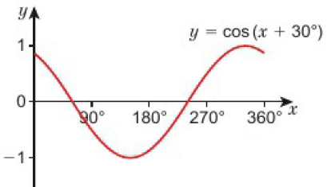
13.9 – Transforming Trigonometric Graphs 2
Page 677
a. b. c. Translation by (${−30 \atop 0}$)
x | 0⁰ | 30⁰ | 60⁰ | 90⁰
cos (x + 30⁰) | $$\frac{\sqrt{3}}{2}$$ | $$\frac{1}{2}$$ | 0 | - $\frac{1}{2}$

Slide 35
13.9 – Transforming Trigonometric Graphs 2
Page 677
a. Translation by (${−60 \atop 0}$) b. Translation by (${−20 \atop 0}$) c. Translation by (${30 \atop 0}$)
a. Translation by (${−40 \atop 0}$) b. Translation by (${−30 \atop 0}$) c. Translation by (${60 \atop 0}$)
a. C b. B c. A

Slide 36
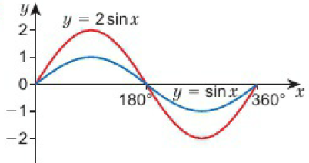
13.9 – Transforming Trigonometric Graphs 2
Page 677
a. c. b.
x | 0⁰ | 30⁰ | 60⁰ | 90⁰ | 120⁰
sin x | 0 | 0.5 | $$\frac{\sqrt{3}}{2}$$ | 1 | $$\frac{\sqrt{3}}{2}$$
2sin x | 0 | $$1$$ | $$\sqrt{3}$$ | 2 | $$\sqrt{3}$$

Slide 37
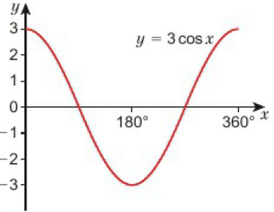
13.9 – Transforming Trigonometric Graphs 2
Page 677
a.

Slide 38
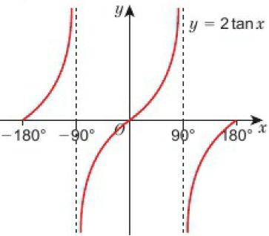
13.9 – Transforming Trigonometric Graphs 2
Page 677
b.

Slide 39
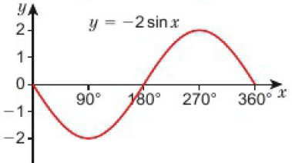
13.9 – Transforming Trigonometric Graphs 2
Page 677
c.

Slide 40
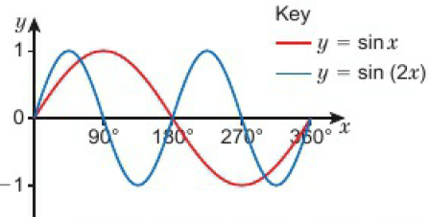
13.9 – Transforming Trigonometric Graphs 2
Page 678
a. c. b.
x | 0⁰ | 30⁰ | 60⁰ | 90⁰ | 120⁰
sin (2x) | 0 | $$\frac{\sqrt{3}}{2}$$ | $$\frac{\sqrt{3}}{2}$$ | 0 | - $\frac{\sqrt{3}}{2}$

Slide 41
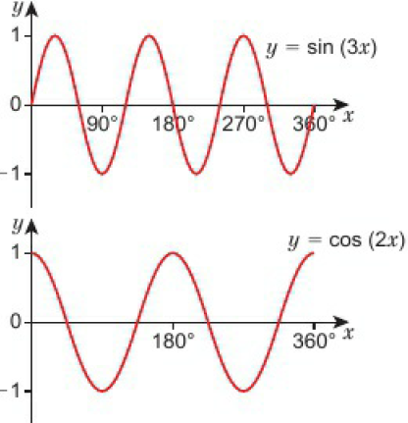
13.9 – Transforming Trigonometric Graphs 2
Page 678
a. b.

Slide 42
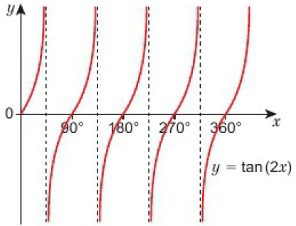
13.9 – Transforming Trigonometric Graphs 2
Page 678
c. y = tan 2x
a. (180, 0) b. (270, -1) c. a = 2, b = 3, c = 1

Slide 43
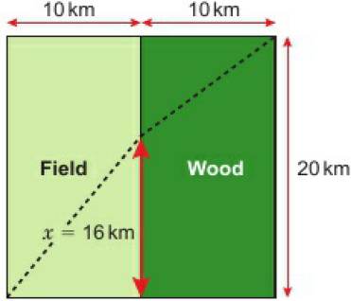
13 – Problem-Solving
Page 678
The distance from A (or B) to the centre of the square is 10$\sqrt{2}$km. The time taken in hours is $\frac{\text{10}\sqrt{2}}{5}$ over the field and $\frac{\text{10}\sqrt{2}}{5}$ through the wood. This is a total of 7$\sqrt{2}$ = 9.90 hours, or 9 hours and 54 minutes, to the nearest minute.
Students' own answers, e.g. the route shown would take 9 hours and 10 minutes to the nearest minute. (12.88km < x < 19.57km)

Slide 44
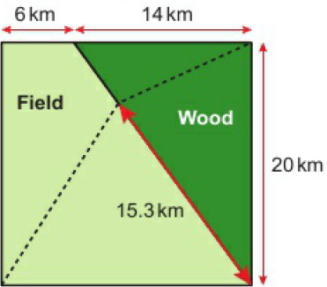
13 – Problem-Solving
Page 678
The quickest possible time is 9 hours and 8 minutes to the nearest minute.

Slide 45
13 – Check-Up
Page 678
Key: UB = upper bound; LB - lower bound
7.96 m²
a. 16.0cm b. 4.61cm
a. 71.7° b. 20.0°
UB: x = 4.5939m (4 d.p.); LB: x = 4.4151m (4 d.p.); x = 4.5m (to the nearest 0.5 metres)
Students' graph of y = tan$θ$for the interval -360° ≤ $θ$ ≤ 360⁰

Slide 46
13 – Check-Up
Page 678
Key: UB = upper bound; LB - lower bound
66°, 294°
a. B b. C c. A
19.5°, 160.5°, 379.5°, 520.5°
23.3 cm (1 d.p.)
a. 15.2cm b. 11.3cm
E.g. tan x = $\frac{1}{\sqrt{3}}$

Slide 47
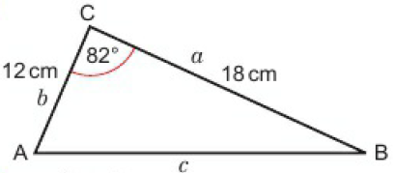
13 – Strengthen
Page 678
Accuracy and 2D problem-solving
Key: UB = upper bound; LB = lower bound
a. b. 107 cm² (3 s.f)
a. 39.6cm² b. 166cm² (3 s.f)

Slide 48
13 – Strengthen
Page 678
a. Triangle labelled correctly b. $\frac{x}{sin 350}$ = $\frac{16}{sin 560}$ c. 11.1 (3 s.f.)
a. 25.4m b. 13.3m
a. Triangle labelled correctly b. $\frac{sinθ}{31}$ = $\frac{sin 1460}{74}$ c. 13.5⁰ (1 d.p.)
a. 50.9° (1 d.p.) b. 25.0° (1 d.p.)
a. Triangle correctly labelled b. x² = 23² + 37² - 2 x 23 x 37 x cos48° c. 27.6cm (3 s.f)

Slide 49
13 – Strengthen
Page 678
a. 68.0m (3 s.f.) b. 61.6m (3 s.f)
a. Triangle correctly labelled b. cos $θ$= $\frac{\text{25}\text{2}\text{ + 32}\text{2} \text{−} \text{41}\text{2}}{\text{2} \text{x} \text{25} \text{x} \text{32}}$ c. 91.1⁰
a. 120.9° b. 27.7°

Slide 50
13 – Strengthen
Page 678
a. b. UB = 0.3987; LB = 0.3827 c. 5.65, 23.5 d. 5.75, 22.5
UB = 10.7294; LB = 9.6295
 | Upper Bound | Lower Bound
5.7 | 5.75 | 5.65
23 | 23.5 | 22.5

Slide 51
13 – Strengthen
Page 679
Trigonometric Graphs
a.
Students’ graph of y = sin x for the interval 0⁰ ≤ x ≤ 90⁰.
d. Students’ graph of y = sin x for the interval 0⁰ ≤ x ≤ 360⁰.
x | 0⁰ | 10⁰ | 20⁰ | 30⁰ | 40⁰ | 50⁰ | 60⁰ | 70⁰ | 80⁰ | 90⁰
sin x | 0 | 0.17 | 0.34 | 0.5 | 0.64 | 0.77 | 0.87 | 0.94 | 0.98 | 1

Slide 52
13 – Strengthen
Page 679
a.
Students’ graph of y = tan x for the interval 0⁰ ≤ x ≤ 80⁰
tan x increases rapidly towards infinity
e, f, Students' graph of y = tan x for the interval 0⁰ ≤ x ≤ 360⁰.
126° or 234° (from graph)
x | 0⁰ | 10⁰ | 20⁰ | 30⁰ | 40⁰ | 50⁰ | 60⁰ | 70⁰ | 80⁰
tan x | 0 | 0.18 | 0.36 | 0.58 | 0.84 | 1.19 | 1.73 | 2.75 | 5.67

Slide 53
13 – Strengthen
Page 679
a.
i. y = sin x, stretch factor 2 in the y direction, translation (${0 \atop −1}$) ii. y = cos x, stretch factor 2 in the y direction iii. y = sin x, stretch factor $\frac{1}{2}$in the y direction, translation (${0 \atop −1}$)
i. B ii. A iii. C
x | 0⁰ | 30⁰ | 90⁰
sin x | 0 | 0.5 | 1
sin 2x -1 | -1 | $\frac{\sqrt{3}}{2}$ - 1 | -1
2sin x -1 | -1 | 0 | -1

Slide 54
13 – Strengthen
Page 679
a.
i. y = sin x, stretch factor 2 in the y direction, translation (${0 \atop −1}$) ii. y = cos x, stretch factor 2 in the y direction iii. y = sin x, stretch factor $\frac{1}{2}$in the y direction, translation (${0 \atop −1}$)
i. B ii. A iii. C
x | 0⁰ | 30⁰ | 90⁰
sin x | 0 | 0.5 | 1
sin 2x -1 | -1 | $\frac{\sqrt{3}}{2}$ - 1 | -1
2sin x -1 | -1 | 0 | -1

Slide 55
13 – Strengthen
Page 679
a. cos x = $\frac{3}{4}$
Students' graph of y = cos x for the interval 0° ≤ x ≤ 720⁰
41.4°
41.4°, 318.6°, 401.4°, 678.6°

Slide 56
13 – 3D Problem Solving
Page 679
a. Students’ sketch of triangle CDG:CG = 25 cm; CD = 21cm; ∠GCD = 90°
32.6 cm (3 s.f.)
Students’ sketch of triangle DFG; FG = 7 cm, DG = 32.6 cm, ZFGD = 90°
12.1°

Slide 57
13 – 3D Problem Solving
Page 679
a. Students’ sketch of triangle ABC; AB = 11 cm, AC = 11cm, ∠BAC = 56°
10.3 cm (3 s.f.)
Students’ of sketch triangle BCD: BC = 10.3 cm, CD = 10cm, BD = 12 cm
72.3°

Slide 58
13 – Extend
Page 679
a. 11.7 cm (3 s.f.)
It is the same as Pythagoras' theorem.
a. $\frac{1}{2}$absin C
$\frac{1}{2}$absin C, $\frac{1}{2}$acsin B
Each expression must have the same value so, $\frac{1}{2}$absin C = $\frac{1}{2}$acsin B absin C = acsin B bsin C = csin B $\frac{b}{sinB}$ ⁼ $\frac{c}{sinC}$

Slide 59
13 – Extend
Page 679
d² = a² + b² + c²
a. a² = h² + b² - 2bx + x²
c² = h² + x²
Substituting for h² + x² in part a gives a² = b² + c² - 2bx
x = cos A, so a² = b² + c² – 2bccos A
116

Slide 60
13 – Extend
Page 679
a. Students’ graph of y = sin x
i. 0.7 (from graph) ii. 0.7 (from graph)
The answers are the same,
The graph is symmetrical about x = 90°.
$\frac{\text{π}r2}{3}$ - $\frac{\sqrt{3}r2}{4}$
1 + $\sqrt{5}$

Slide 61
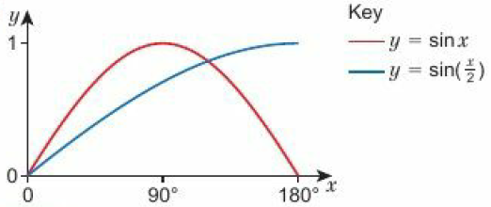
13 – Extend
Page 679
a. c.
x | 0⁰ | 30⁰ | 90⁰ | 120⁰
sin ($\frac{x}{2}$) | 0 | 0.5 | 0.7 | 0.9

Slide 62
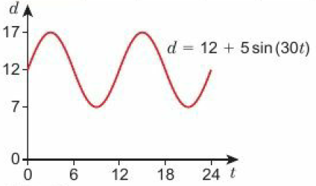
13 – Extend
Page 679
1130cm³
33.6°
a. x = 5 b. x = 10

Slide 63
13 – Unit Test
Page 679
Sample student answer
The student has assumed wrongly that the triangle is right-angled.

